Slide 1

JS Design Patterns

Slide 2

Outline
What are Design Patterns?
Why Design Patterns?
What to learn?
Types of Design Patterns
Design patterns in JavaScript
Modern Modular JavaScript Design Patterns
Design Patterns

Slide 3
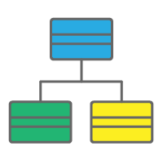
What are Design Patterns?
Are Design Patterns Classes?

Slide 4

What are Design Patterns?
Are Design Patterns Packages?

Slide 5
What are Design Patterns?
Are Design Patterns Libraries?
Libraries

Slide 6
What are Design patterns?
They are NOT classes, packages or libraries that you can plug into your application and WAIT for the MAGIC to happen.
Design patterns are SOLUTIONS to recurring problems, guidelines on how to tackle certain problems.
It is a description or template for how to solve a problem that can be used in many different situations.

Slide 7
What all are the problems you may face while writing code?

Slide 8
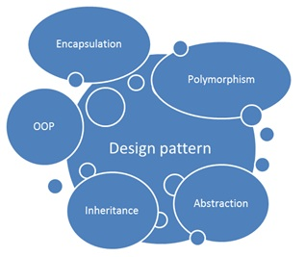
Why design Patterns?
Every developer strives to write code with
Maintainable code
Structured code
Readable code
Reusable code.
Design patterns prove crucial to solve these challenges, providing an organized structure for common issues in a particular circumstance.
Code structuring becomes more important as applications become larger.

Slide 9
Types of design patterns
In software development, design patterns are generally grouped into a few categories.
Creational patterns focus on ways to create objects or classes.
Structural design patterns focus on ways to manage relationships between objects so that your application is architected in a scalable way.
Behavioral patterns focus on communication between objects.

Slide 10
What to learn?
Each pattern consists of many properties, though, we will emphasize the following key points:
Context: Where/under what circumstances is the pattern used?
Problem: What are we trying to solve?
Solution: How does using this pattern solve our proposed problem?
Implementation: What does the implementation look like?

Slide 11

Design patterns in JavaScript
JavaScript web developers frequently interact with design patterns, even unknowingly, when creating applications.
Although there is a diverse list of design patterns used in certain circumstances.
Common issues where design patterns are used in JavaScript
Data Types in JavaScript
Dealing with Privacy

Slide 12
Patterns in Quest
Modern Modular JavaScript Design Patterns
AMD
CommonJs
ECMAScript
ES6, ES7/ES2016,ES 2017

Slide 13
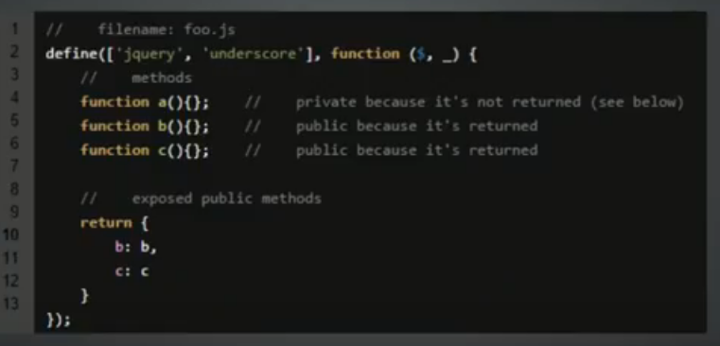


Slide 14
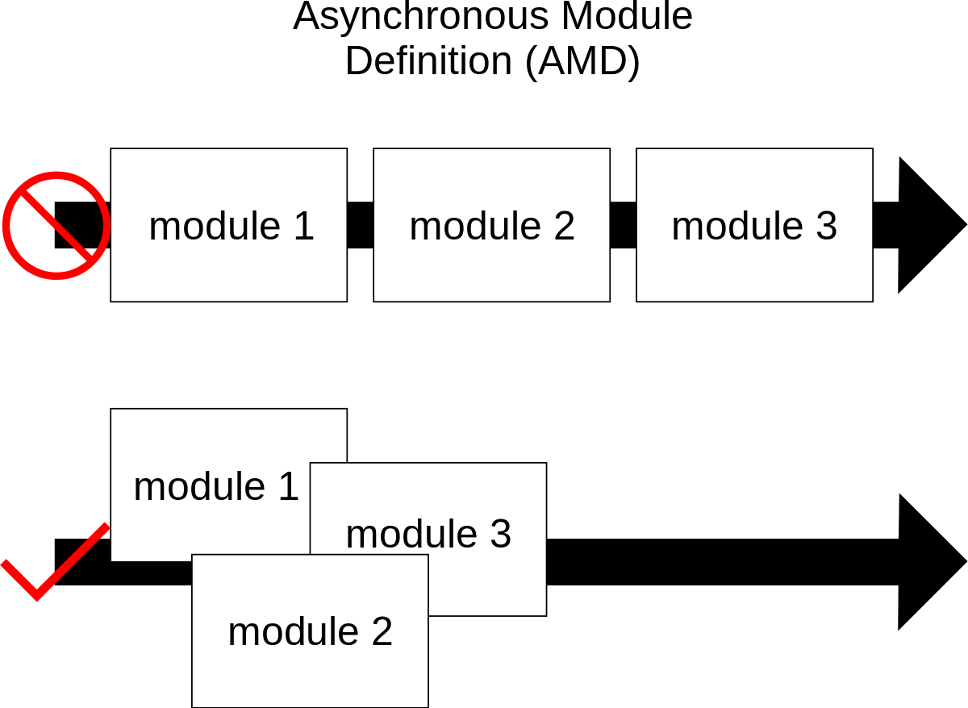
AMD-Asynchronous Module Definition
Implementations of AMD provide the following benefits:
Website performance improvements.
AMD implementations load smaller JavaScript files, and then only when they are needed.
Fewer page errors.
AMD implementations allow developers to define dependencies that must load before a module is executed.

Slide 15
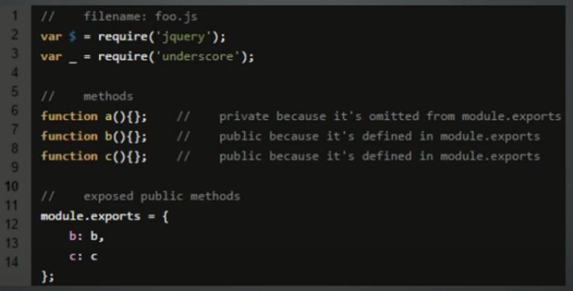


Slide 16

CommonJS
The CommonJS group defined a module format to solve JavaScript scope issues by making sure each module is executed in its own namespace.
To achieve this CommonJS gives you two tools: The require() function, which allows to import a given module into the current scope. The module object, which allows you to export something from the current scope.
Notes:
var Dal = (function () { function Dal() { } Dal.prototype.Add = function () { alert("Dal add called"); }; return Dal; }()); exports.Dal = Dal;

Slide 17
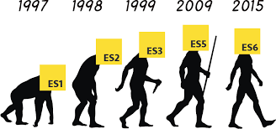
ES Harmony, the the successor to ECMAScript 5
EcmaScript is the standardized scripting language that JavaScript (and some other languages, like ActionScript) implement.
There are quite a few new features in ES6, many still in draft form.
Classes
Arrow Functions
Modules
Block Scoping
Promises

Slide 18
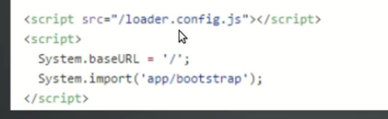


Slide 19
Patterns in Quest
The design patterns in quest include the following:
Constructor
Module
Prototype
Observer
Singleton
Mixin

